Slide 1
BIG DATA ANALYTICS PROJECT
Phase 2
LAHARI KOPPOLU

Slide 2
MEET
THE TEAM
Lahari Koppolu
Kumari Shivani
Sreenivas Reddy
Year of Data - 2000
Year Of Data - 2007
Year of Data- 1994
LAHARI KOPPOLU

Slide 3
Date Preparation in Hive
Agenda
Sampling Records
Populate the Delayed Column
Data Export and Combination
Machine Learning Model
Model Selection and Evaluation
01
02
03
04
05
06
LAHARI KOPPOLU

Slide 4
YEAR OF DATA 2000
LAHARI KOPPOLU

Slide 5
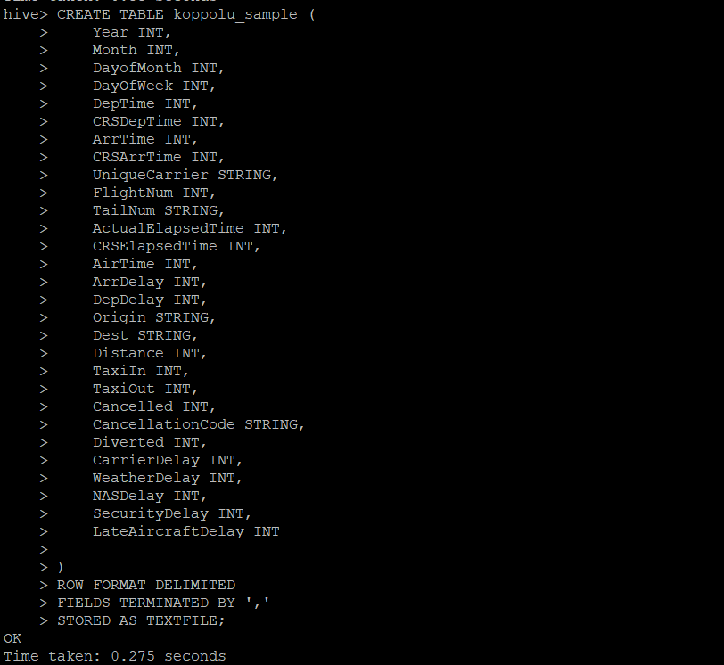
Create and Modify Hive Table
Add a New Column: The table is updated by adding a Delayed column of type STRING.
LAHARI KOPPOLU

Slide 6
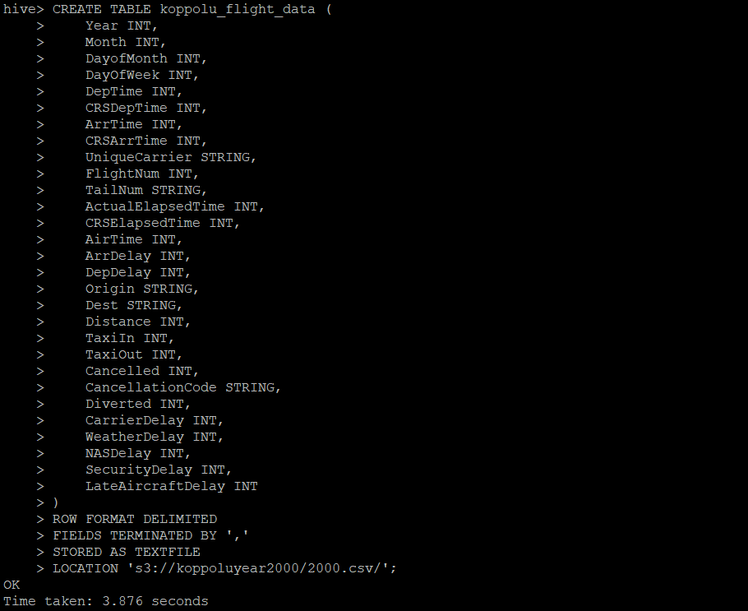
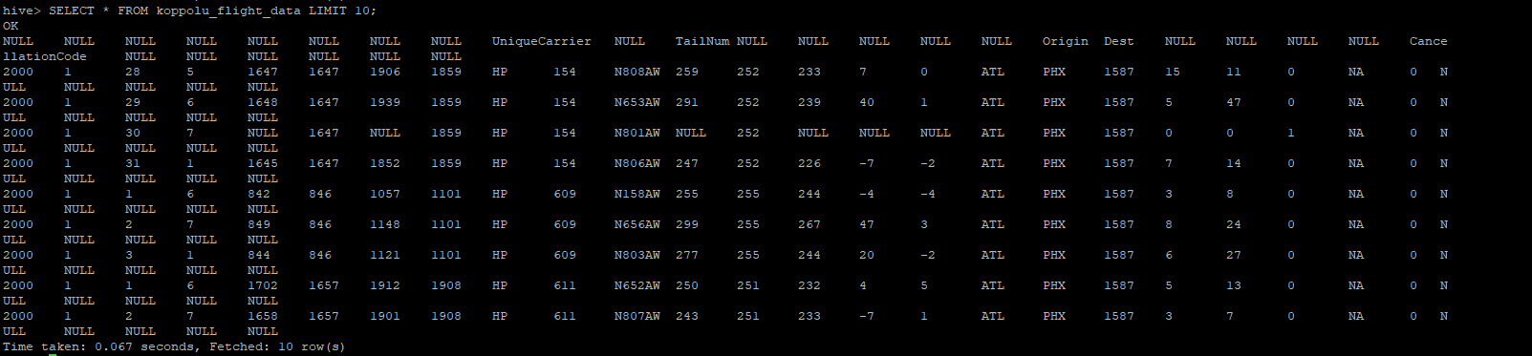
Flight Data Table Creation (Year 2000)
Table Creation:
A Hive table, koppolu_flight_data, is created to store flight details for the year 2000.Fields include flight times, delays, carrier information, and other relevant attributes.
Data Loading:
Data from a CSV file located at /koppoluyea2000/2000.csv is loaded into the table.
Verification:
A query to fetch the first 10 rows confirms successful data import and table structure.
LAHARI KOPPOLU

Slide 7
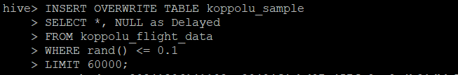
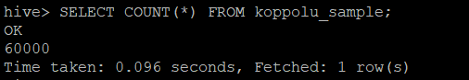
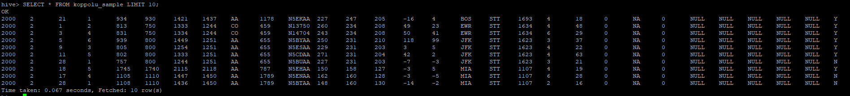
Sampling and Loading Records
Random Sampling:
A random sample of 60,000 records is selected from the flight_data table using the rand() function.
Data Insertion:
The sampled records are inserted into the koppolu_sample table with a placeholder column Delayed.
LAHARI KOPPOLU

Slide 8
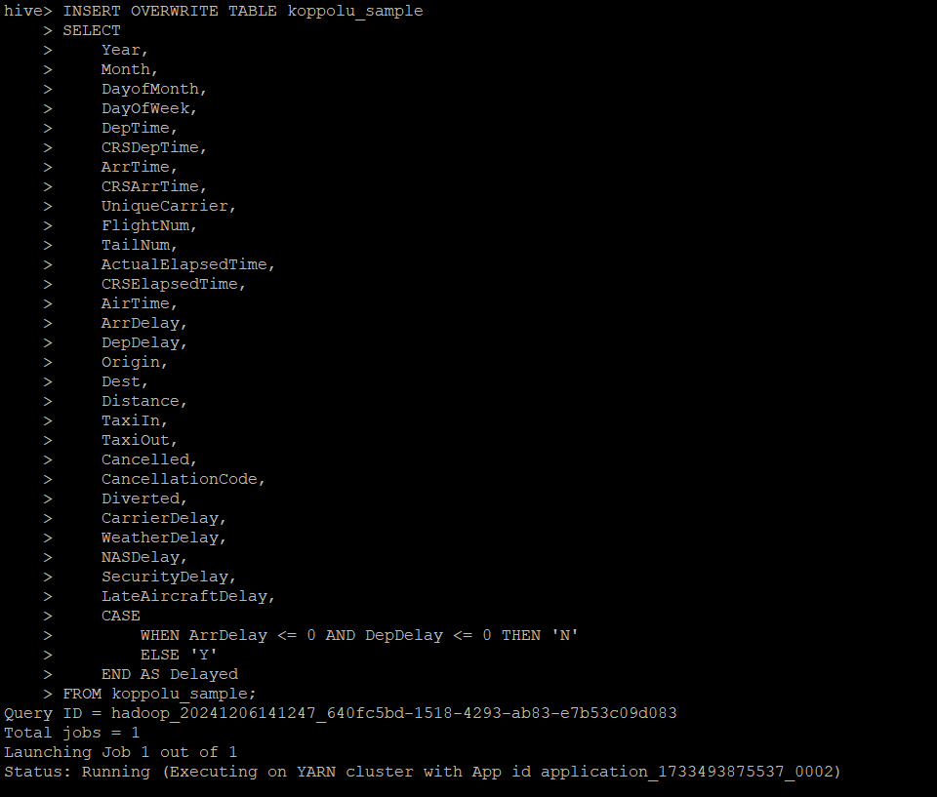
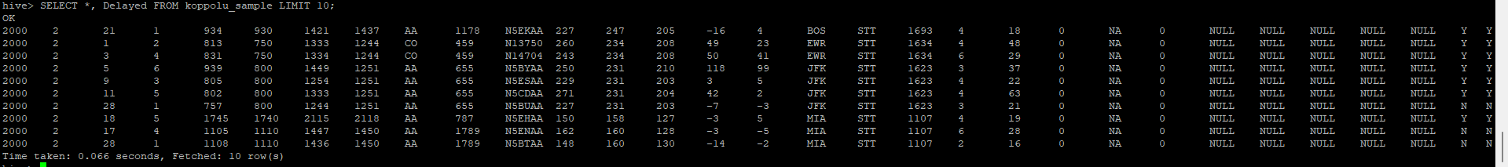
Populate Delayed Column
Updated the "Delayed" column in `koppolu_sample` based on conditions:
- 'N' if `ArrDelay` and `DepDelay` ≤ 0.
- 'Y' otherwise.
Used `INSERT OVERWRITE` with a `CASE` statement and validated results with a `SELECT` query.
LAHARI KOPPOLU

Slide 9
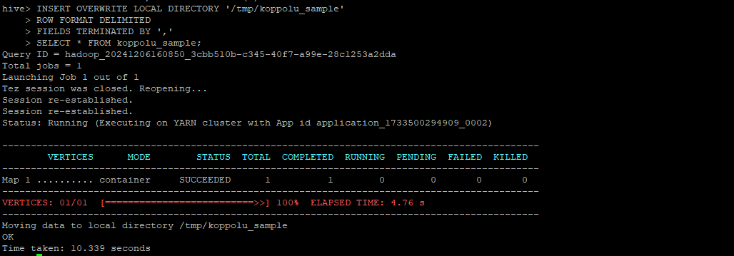
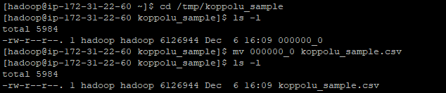
Extract 60,000 Sample Records
Export 60,000 sampled records from Hive.
Steps:
Query Execution: Used INSERT OVERWRITE with local directory to export records.
Result Verification: Confirmed the data export using file size and time logs.
Outcome: Sample records successfully saved locally as koppolu_sample.csv.
LAHARI KOPPOLU

Slide 10
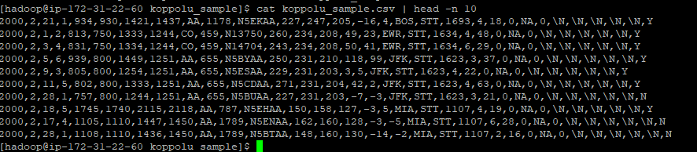
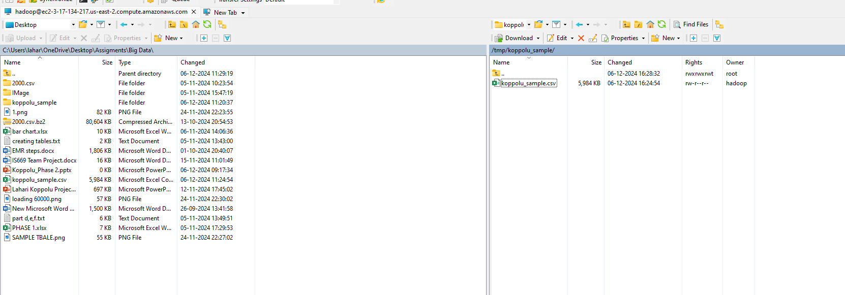
Verify & Download Sample Data
Validate and review exported sample records.
Steps:
Data Preview: Used head command to inspect the first 10 rows of the file.
Local Access: Verified koppolu_sample.csv availability on the local system.
Outcome: Sample data reviewed and ready for further analysis.
LAHARI KOPPOLU

Slide 11

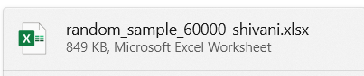


Combining Team Files
Merge sample year files from all team members into a single dataset.
Files Involved:
koppolu_sample.csv
random_sample_60000-shivani.xlsx
Extracted_1994.csv
Final_append.csv
Final combined dataset containing 180,000 records for analysis.
LAHARI KOPPOLU

Slide 12
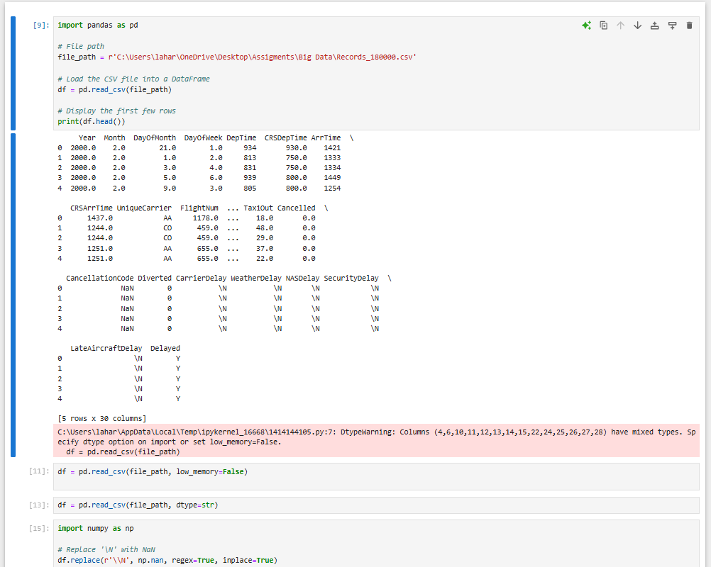
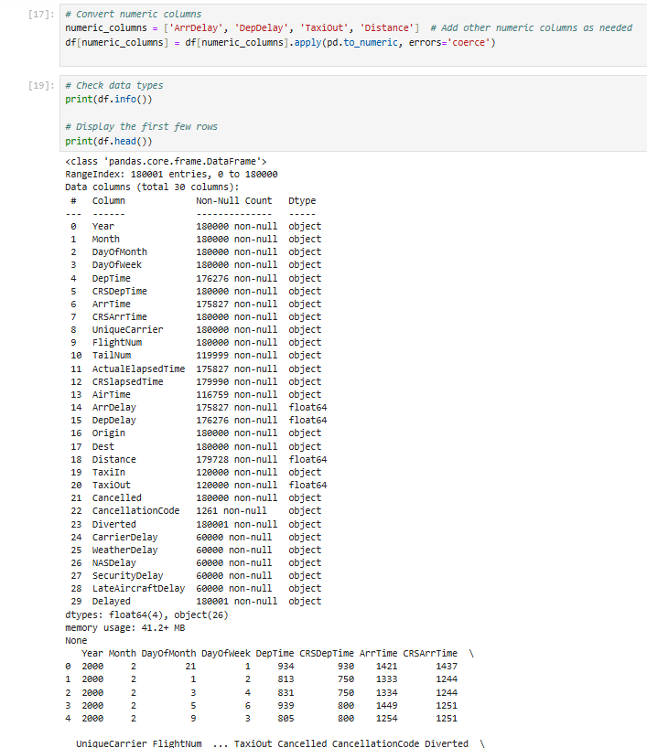
DATA CLEANING
LAHARI KOPPOLU

Slide 13
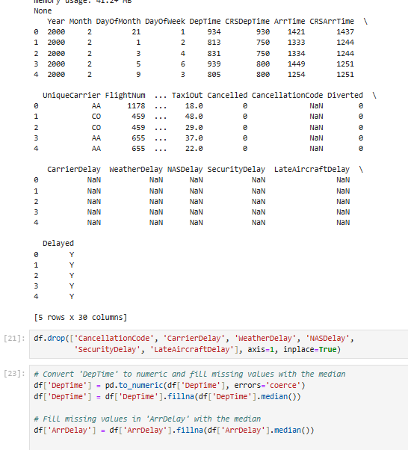
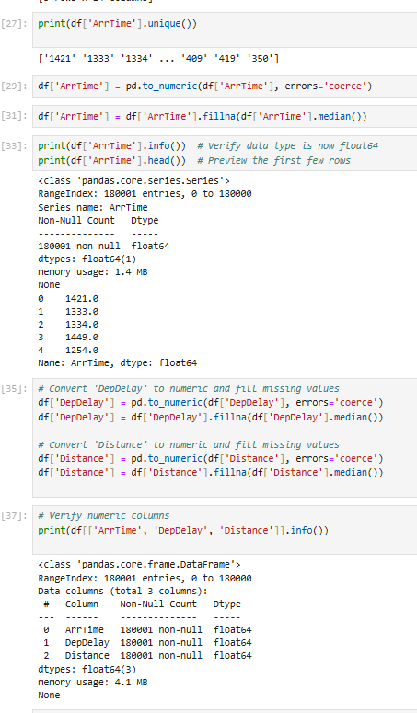
DATA CLEANING
LAHARI KOPPOLU

Slide 14
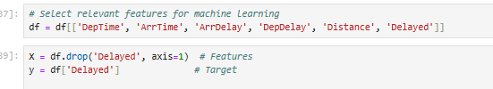
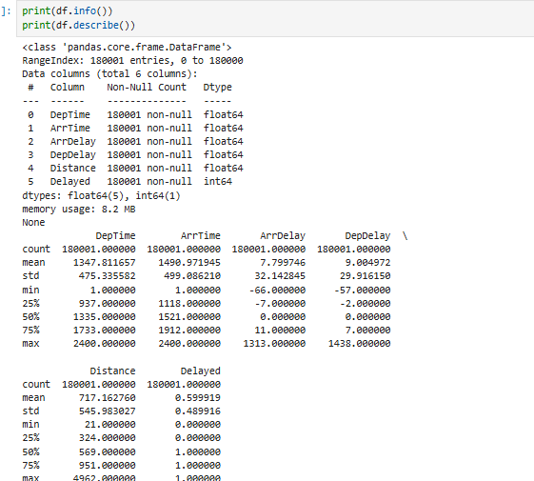
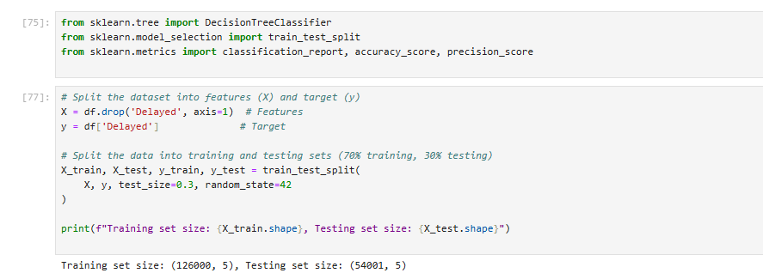
Model Training – Decision Tree
Training and Testing sets:
Data Splitting:
Split the dataset into features (X) and the target (y), where the target variable is Delayed.
Use train_test_split from sklearn to divide the dataset into:
Training set (70%): Used to train the Decision Tree model.
Testing set (30%): Used to evaluate the model.
LAHARI KOPPOLU

Slide 15
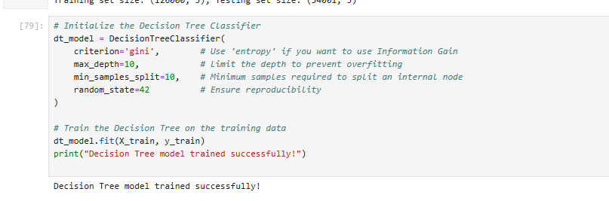
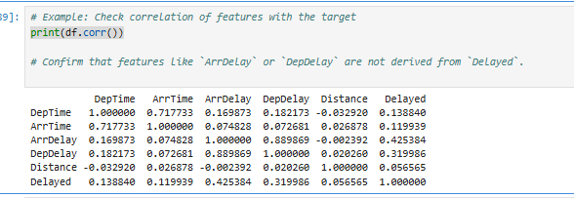
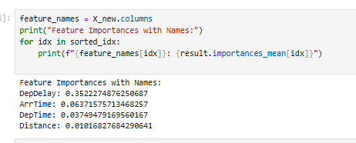
Train the Decision Tree Model
Train a Decision Tree Classifier using the training dataset.
Details:
- Criterion: Gini index used to measure node impurity.
- Depth Limit: Maximum depth set to prevent overfitting.
- Minimum Samples Split: Ensures nodes split only when enough samples are available.
- Random State: Set for reproducibility.
LAHARI KOPPOLU

Slide 16
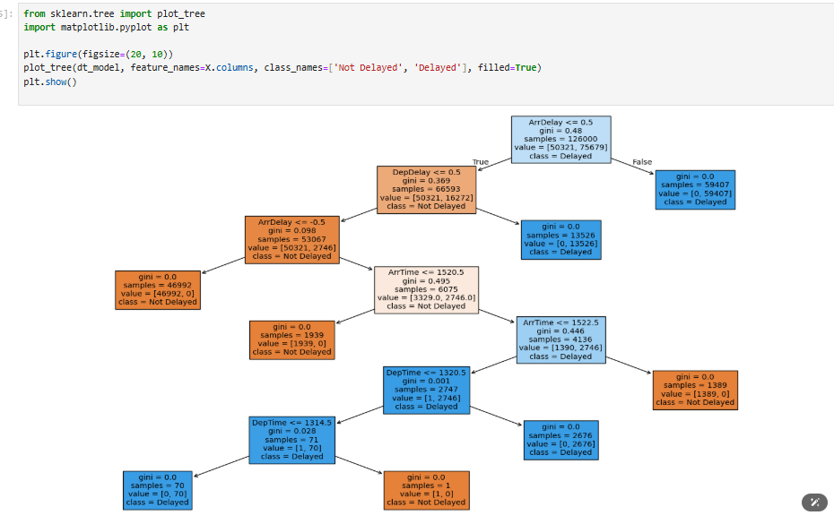
Decision Tree Model
LAHARI KOPPOLU

Slide 17
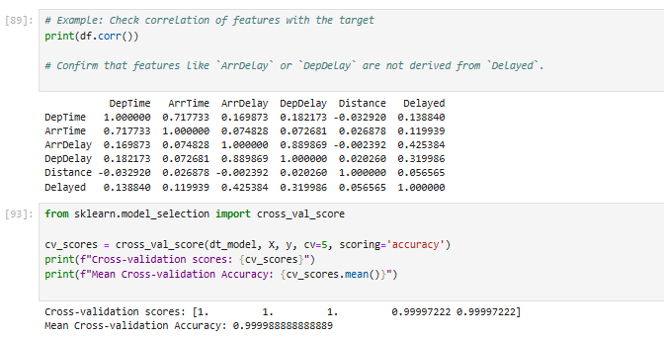
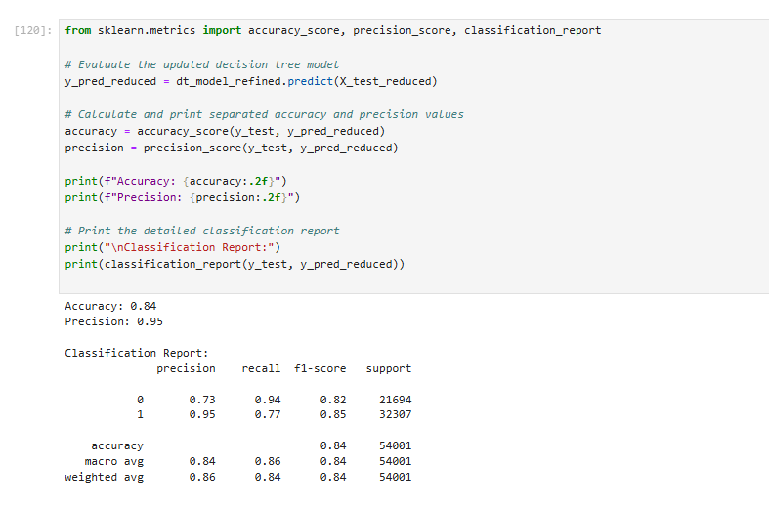
Evaluate the Model
LAHARI KOPPOLU

Slide 18
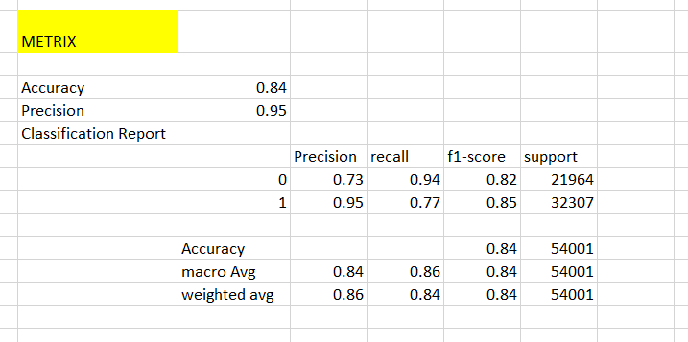
METRIX
Key Metrics:
Accuracy: Measures the overall correctness of the model. Achieved 84%.
Precision: Focuses on the accuracy of positive predictions. Achieved 95%.
Detailed Insights:
The classification report shows precision, recall, and F1-score for each class (Delayed and Not Delayed).
Macro and weighted averages provide a balanced view across all classes.
The evaluation confirms that the model performs well, particularly for identifying delayed flights.
LAHARI KOPPOLU

Slide 19
Conclusion
The Decision Tree model achieved 84% accuracy and 95% precision, demonstrating strong performance in identifying delayed flights. The model effectively predicts flight delays and can be used for operational decision-making. To further enhance performance, the model can be fine-tuned, and other algorithms can be explored.
LAHARI KOPPOLU

Slide 20
Team Conclusion
After careful observation and evaluation of the model performance metrics on Decision Tree, SVM, Logistic Regression, the team has chosen SVM (Support Vector Machine) as the best prediction model.
Reasons for Selection:
Accuracy: Achieved a high accuracy of 91%, meeting the desired threshold.
Precision: Precision of 92%, ensuring minimal false positives.
Overall Performance: The model outperforms others in terms of balanced classification metrics, making it reliable for predicting flight delays.
LAHARI KOPPOLU

Slide 21
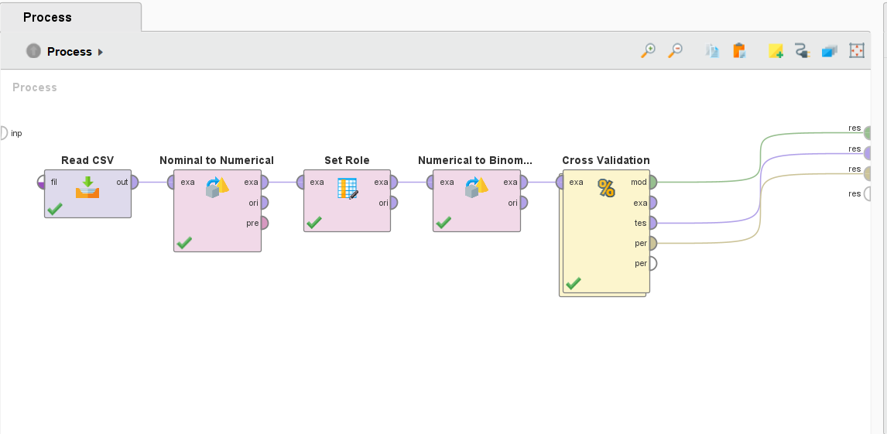
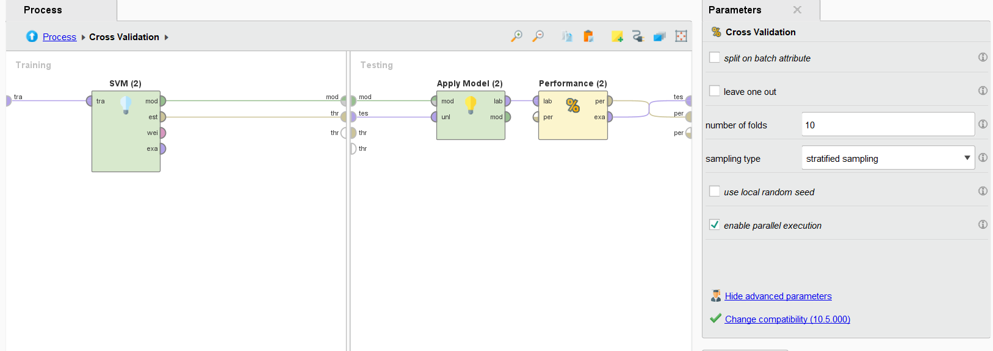
Predicte 10 Records by svm model
LAHARI KOPPOLU

Slide 22
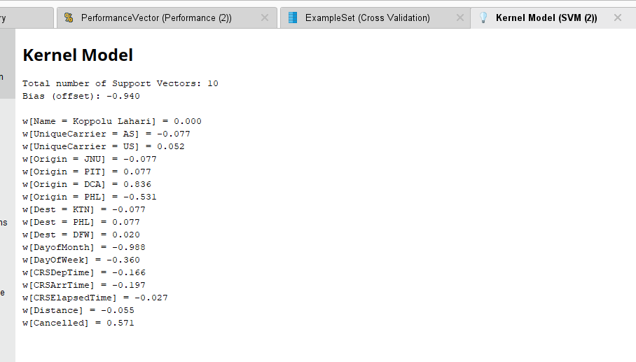
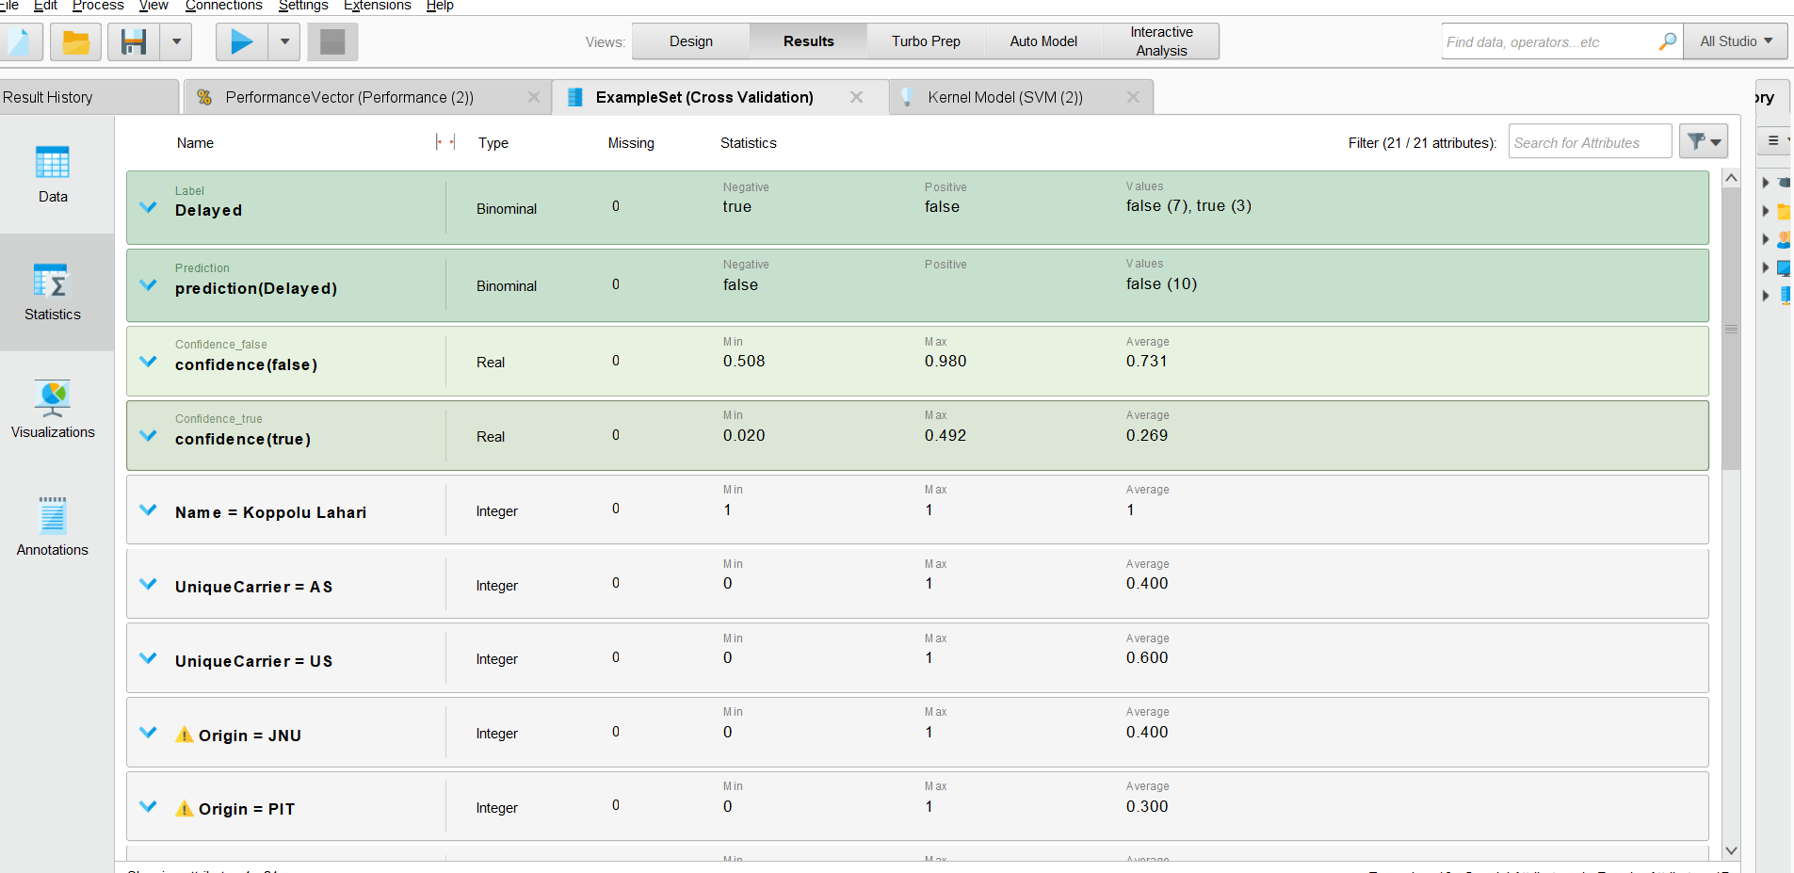
Continuation Process
LAHARI KOPPOLU

Slide 23
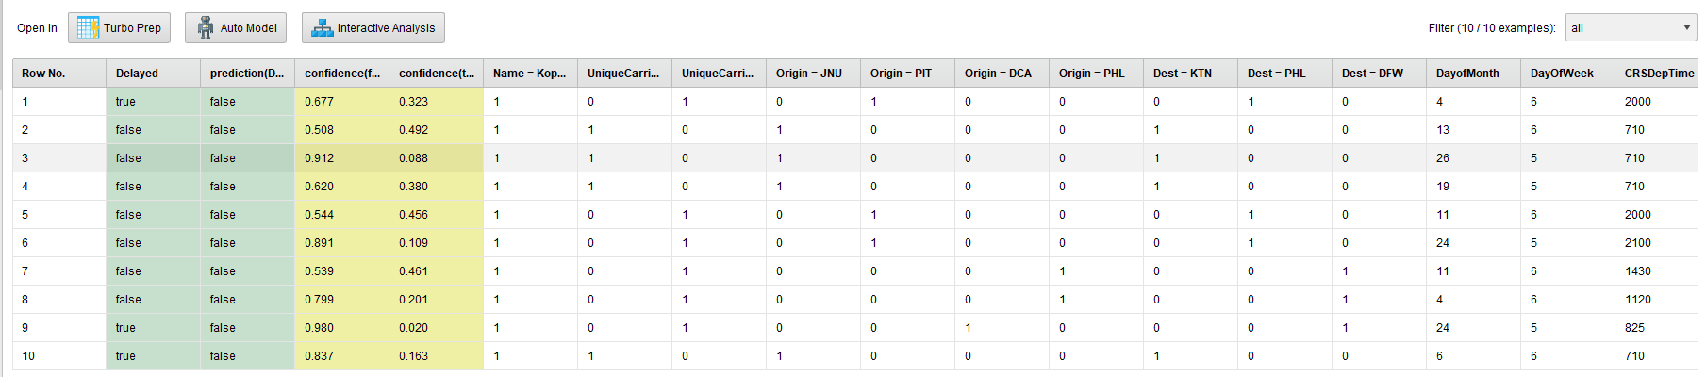
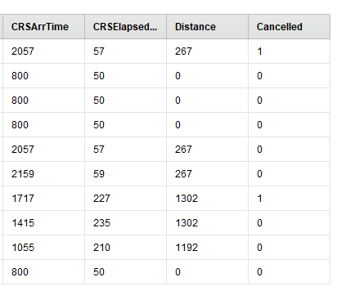
Predicted 10 Records
LAHARI KOPPOLU

Slide 24
THANK YOU
LAHARI KOPPOLU

